Slide 1

ARTIFICIAL INTELLIGENCE
PHASE 1

Slide 2
CREATE A CHATBOT IN PYTHON
TEAM MEMBERS
TEAM LEADER : KAVIBHARATHI G (731221205012)
TEAM MEMBERS : BHUVANESWARAN M (731221205003)
BOOPATHI C (731221205004)
DHAYALAN R (731221205008
RAVIKUMAR M (731221205034)

Slide 3
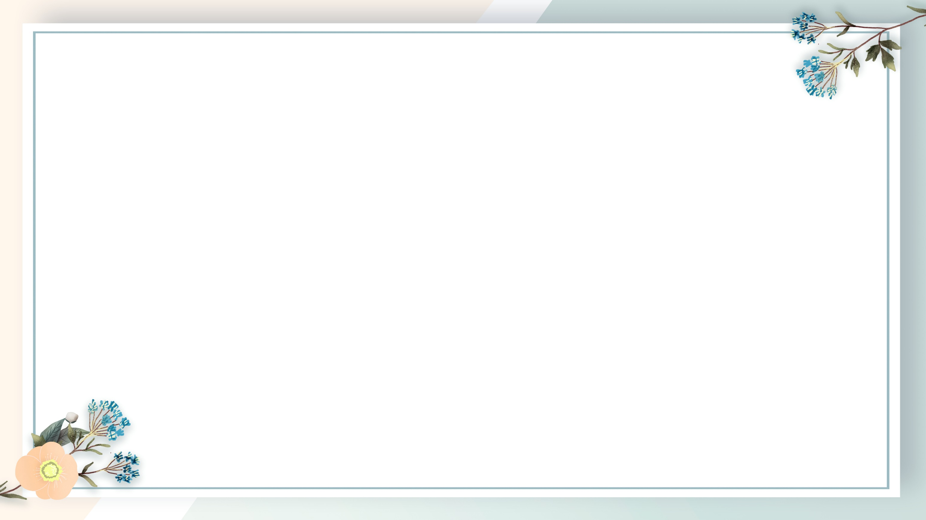
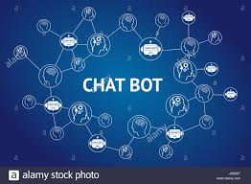
What is CHATBOT
Chatbot is a computer program that simulates and processes human conversation (either written or spoken), allowing humans to interact with digital devices as if they were communicating with a real person.

Slide 4
Types of Chat bot:
Menu/button chat bot.
Linguistic based.
Keyword recognition-based chat bots.
Machine Learning chat bots.
The hybrid models.
Voice bots.

Slide 5
Objectives:
It provides 24/7 availability.
Themes.
Voice-to-text.
Language.
Customize Chatbot.
Quality of conversation.

Slide 6
DIFFERENT MODELS OF CHATBOT
Language Learning Bot
Weather Information Bot
Recipe Recommender Bot
Job Search Assistant
News and Updates Bot
Personal Assistant Bot
E-commerce Product Finder
AI Storytelling Bot
Mental Health Support Bot

Slide 7
Language Learning Bot: Develop a bot that helps users practice a new language by engaging in conversations and providing feedback.
Weather Information Bot: Create a bot that can provide current weather conditions and forecasts for a specified location.
Recipe Recommender Bot: Design a bot that suggests recipes based on user preferences and available ingredients.

Slide 8
Job Search Assistant:
Build a bot that helps users find job listings, assists in preparing resumes, and provides interview tips.
News and Updates Bot:
Develop a bot that aggregates news articles on specific topics and provides summaries or links.
Personal Assistant Bot: Create a bot that can help users with tasks like setting reminders, scheduling events, sending emails, etc.

Slide 9
E-commerce Product Finder:
Build a bot that assists users in finding products on an e-commerce website based on their preferences.
AI Storytelling Bot:
Create a bot that generates short stories or fictional narratives based on user prompts.
Mental Health Support Bot:
Create a bot that offers resources, coping strategies, and a listening ear for users struggling with mental health issues.

Slide 10
User Documentation:
Include instructions guide on how to use the chatbot.
Resources:
Estimation the resources needed for the project.
Security:
Explain how you will ensure data security.
Testing:
Outline your testing strategy , including unit tests , integration tests and user acceptance testing.

Slide 11
Functionalities and Features:
Detail the capabilities and features of the chatbot.
Natural Language Processing:
Explain how the chatbot will understand and respond to user input.
User Interface Design:
Provide wireframes of how the chatbot interface will look.
Conclusion:
Summarize the key points and reiterate the projects objectives.

Slide 12
PROJECT DETAILS
Step 1: Set up your project directory Create a directory for your project.
Step 2: Initialize a Python virtual environment A virtual environment isolates your project's dependencies from the system-wide Python environment.
Step 3: Install necessary libraries Install Flask for the web interface and Chatterbot for the chatbot engine.
Step 4: Create the main Python file Create a Python file
Step 5: Create the templates folder Create a folder named templates inside your project directory. This is where your HTML templates will reside.
Step 6: Create the HTML template Inside the templates folder, create an HTML file
Step 7: Run the application In your terminal

Slide 13
Thanking you
Mentor
Evaluator
SPOC
HOD

